Slide 1
Big Data Basics
Big Data Analytics with Python, AIMS-Rwanda 2022
Dunstan Matekenya, PhD

Slide 2
Outline
What is Big Data?
What can we do with Big Data?
What are the sources of Big Data?
Big Data tools and ecosystem
Distributed data processing
How to work with large datasets in Python
Further readings

Slide 3
Whats Big Data?
How big is big?
Whats makes Big Data different from small data?
Is there such a thing as small data?
What are the characteristics of Big Data?

Slide 4
Exercise: Tracking the Big Data Hype
Using the Google trends site check how the popularity of the search term “Big Data” has declined compared with similar search terms: machine learning and artificial intelligence

Slide 5
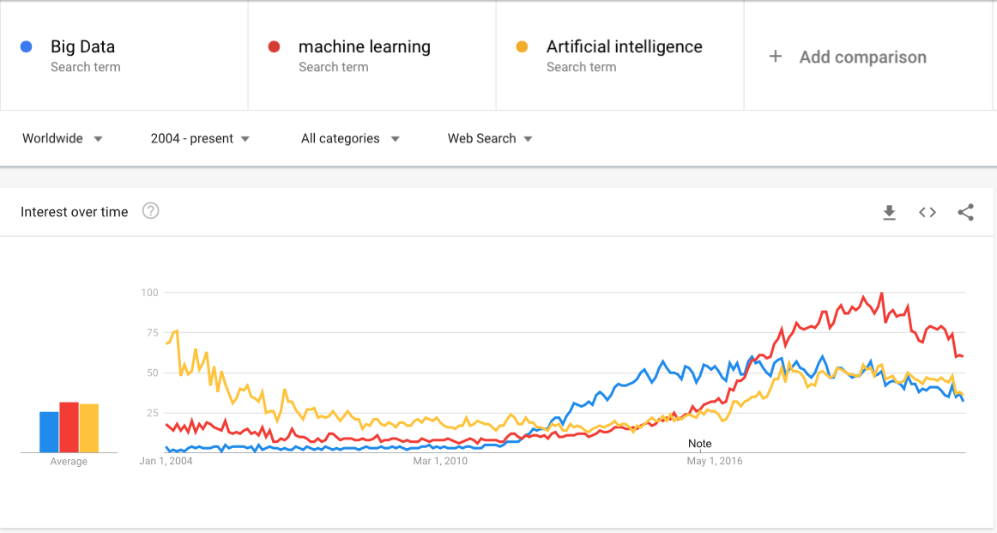
Popularity of ‘Big Data’ Search Term on Google

Slide 6
What exactly is Big Data?
Big data is larger, more complex data sets, especially from new data sources. This data is characterized by the fact that it contains greater variety (texts, images, audios, videos etc), arriving in increasing volumes and with more velocity.
These data sets are so voluminous that traditional data processing software just can’t manage them

Slide 7
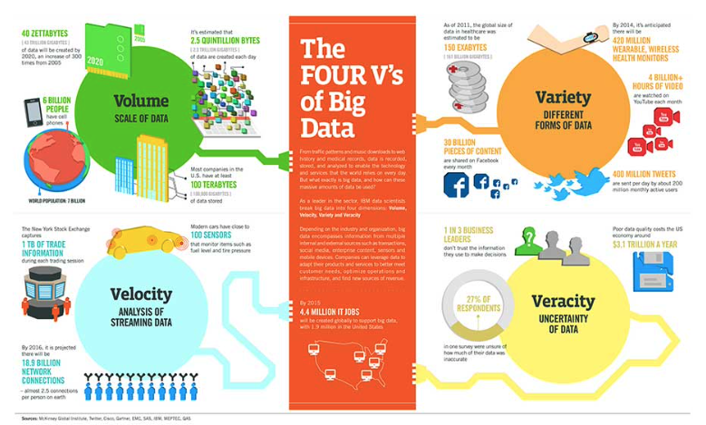
Characteristics of Big Data-The 4 V’s

Slide 8
Characteristics of Big Data-The 4 V’s
Volume: The amount of data matters. For Big Data, we are often talking about large volumes of data. Although the question often comes, how big is big?
Velocity: Velocity is the fast rate at which data is received and (perhaps) acted on.
Variety: Variety refers to the many types of data that are available. Traditional data types were structured and fit neatly in a relational database. With the rise of big data, data comes in new unstructured data types. Unstructured and semistructured data types, such as text, audio, and video, require additional preprocessing to derive meaning and support metadata.
Veracity: The data is often noisy

Slide 9
History of Big Data
Previously, large datasets were available through satellite images and others sources.
Explosion in size of datasets came with the coming of internet companies such as Facebook, Youtube and others around 2005
Hadoop and Mapreduce framework were created in 2006 specifically to deal with large datasets at Google
Since then, the advent of IoT, more mobile devices and increased access to internet has contributed to ever increasing datasets

Slide 10
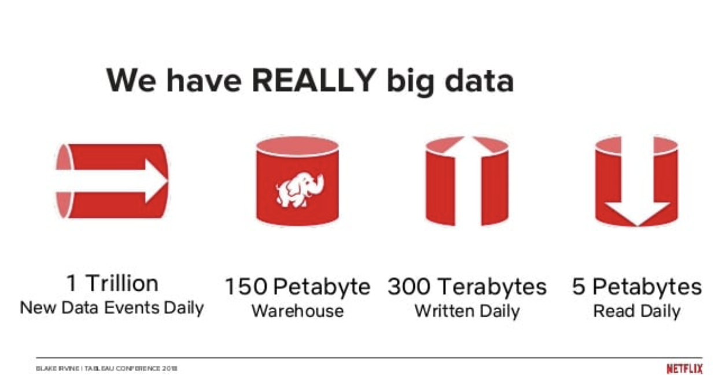
Examples of Big Data
Articles talking about Big Data volumes
Very Big Data at Netflix
This old article has some interesting stats BUT no way to know how accurate it is
Yet another article

Slide 11
Applications of Big Data?

Slide 12
Industries Using Big Data
What Do they Do with the Data?
Online Retail
Search
Finance
Amazon uses its massive data to build recommendation systems
Netflix uses data to predict customer viewer behavior
Google uses search data to improve search results and optmize ranking of results
Google uses its data for advertising
And more and more
Manufacturing
Automobile
Medicine
Telecom
Entertainment
Insurance

Slide 13
Big Data Tools and Ecosytem

Slide 14




What Do We Want to Do with Big Data?
Store, manage and retrieve
Analyze and visualize
Build models (ML)
The Big Data tools, methodologies, frameworks and ecosystems address these tasks. Most technologies combine several aspects. For instance, with Hadoop, you have both storage and analysis capabilities

Slide 15
Tools and Platforms
NoSQL Databases
Hadoop, HDFS, Apache Spark, Mapreduce
Cloud providers
Data storage, management
Compute for data processing, analysis and visualization
Examples: AWS, Google Cloud Platform (GCP), Microsoft Azure
Store large datasets at scale
Store data in JSON instead of relational tables
NoSQL database types include pure document databases, key-value stores, wide-column databases and graph databases
Examples: MongoDB, CouchDB, Cassandra and Redis
Data lake is a relatively new architecture in data storage
Provides distributed storage
Data analytics, machine learning
Parallel data processing
Example vendors: Cloudera, Hortonworks, Databricks

Slide 16
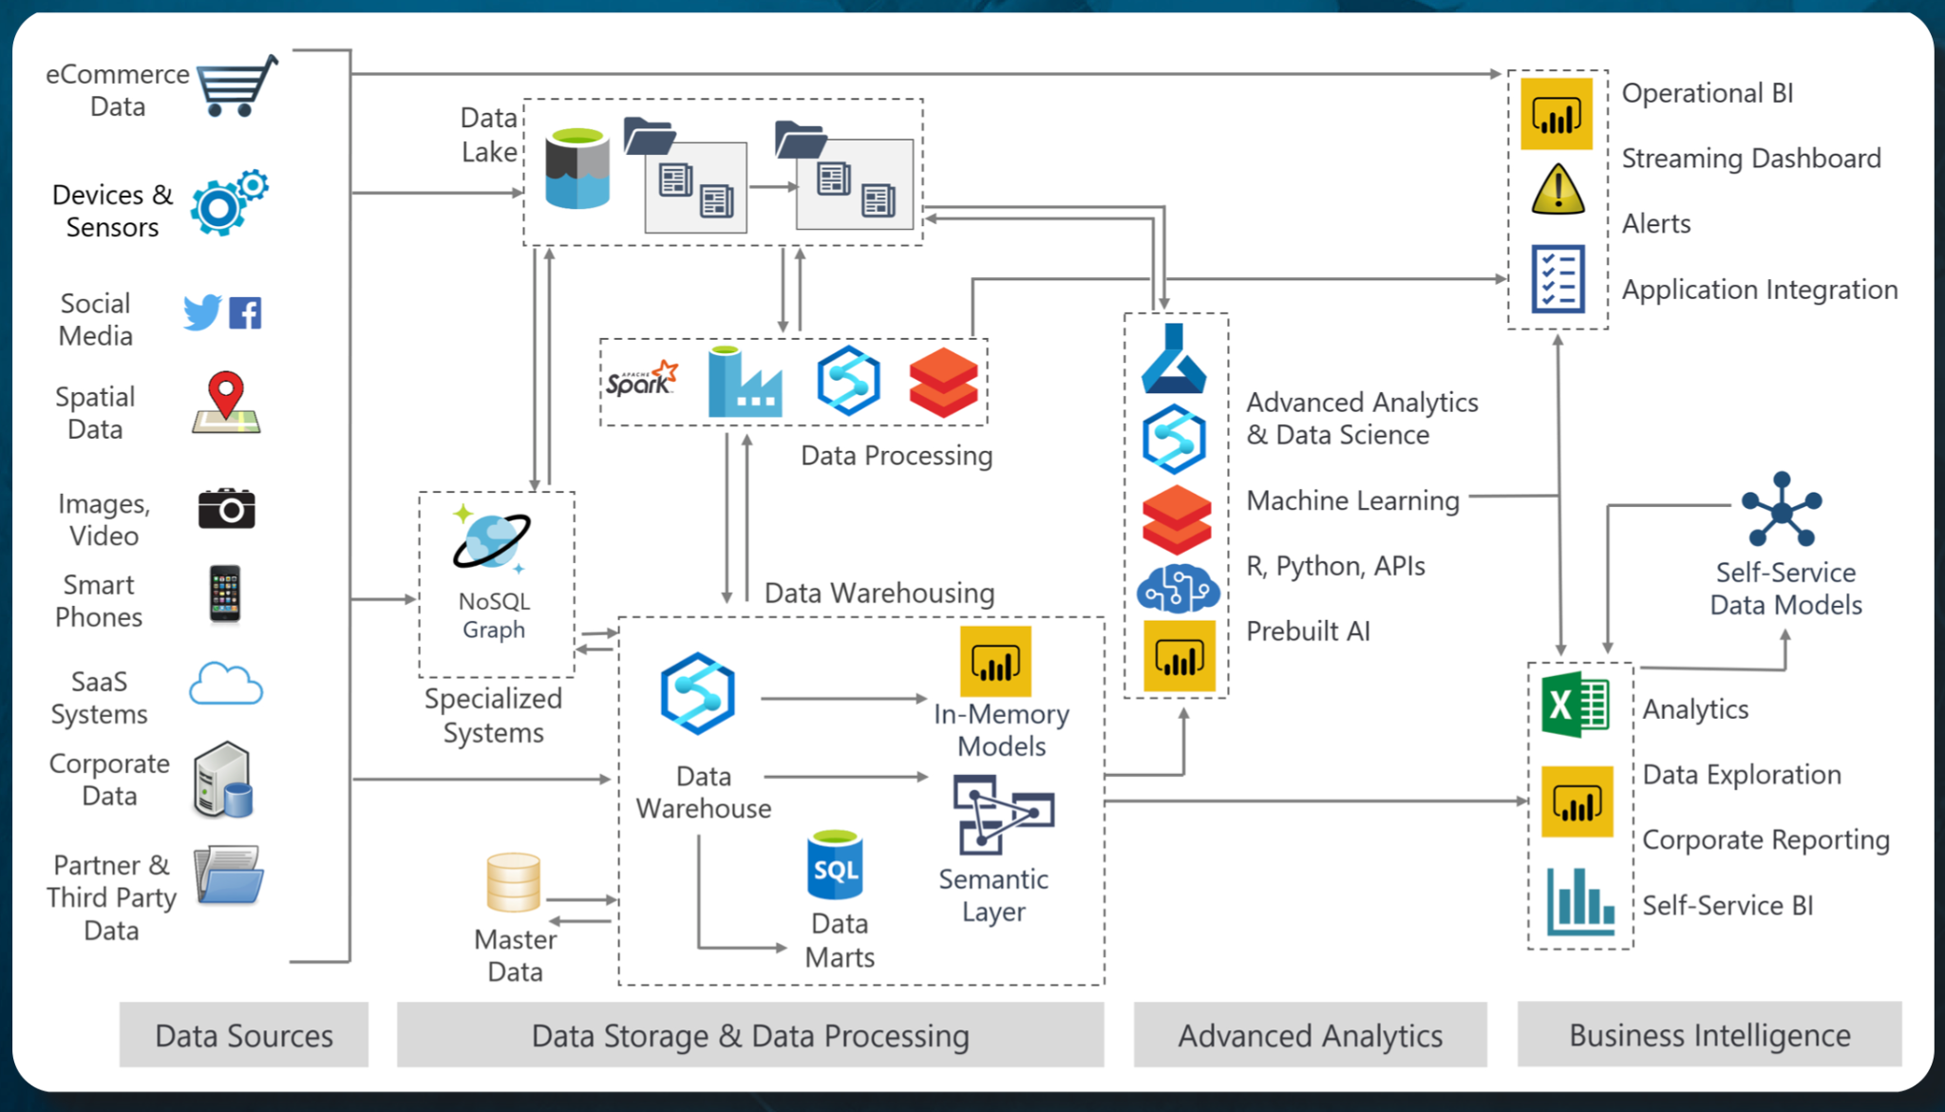
How Some of these Components Look in a Full System

Slide 17
Summary on Big Data
Big Data, when it comes to size is a relative term BUT you will know you have a large dataset if you can’t process it on a single computer or you can’t use traditional software such as Excel to handle the data
The Big Data technology landscape is now dominated by cloud providers such as AWS, Google, Azure and others. Other notable vendors involved include Databricks, Cloudera/Hortonworks, MapR
Big Data has penetrated many industries including government

Slide 18
Further Reading on Big Data Basics
This PDF book on Big Data is a good resource to look through
If you want to understand data lakes and data warehouses more, take a look at this eBook

Slide 19
Big Data and Parallel Processing

Slide 20
What is Parallel Processing
Parallel computing is a computation style of carrying out multiple operations simultaneously using one (by means of multi-threading) or many machines. Parallel computing works on the principal that large problems can often be divided into small problems and these small problems can be executed concurrently.
Task parallelism-This form of parallelism covers the execution of computer programs across multiple processors on same or multiple machines. It focuses on executing different operations in parallel to fully utilize the available computing resources in form of processors and memory.
Data parallelism- This form of parallelism focuses on distribution of data sets across the multiple computation programs. In this form, same operations are performed on different parallel computing processors on the distributed data subset.
Most Big Data Frameworks utilize both data and task parallelism

Slide 21
Similar Concepts to Parallelism
Distributed computing
Concurrent processin

Slide 22
Why Parallel Processing?
In this single node/single setup, if you have too much data and/or too many computations to perfom, its difficult to scale
Parallel or distributed processing is the cornerstone of working with Big Data
Compute (CPU)
Storage
Single node setup

Slide 23
Parallel vs. Linear Processing
Linear/sequential processing
Parallel processing
Problem
Problem
Instruction-1
Instruction-2
Instruction-N
Instruction-1
Error
Instruction-2
Output
Error
Instruction-N
Output

Slide 24
Advantages of Parallel Processing
Faster: Parallel processing can process large datasets in a fraction of time
Less compute: Less memory and compute requirements needed as compute instructions are distributed to smaller execution nodes
Scalability: More execution nodes can be added or removed from the execution network depending on the problem

Slide 25
Vertical Scaling Vs. Horizontal Scaling
Compute
Compute
Compute
Eventually vertical scaling fails

Slide 26
Horizontal Scaling is Better
Compute
Compute
Compute
Compute
Compute
Storage
Storage
Storage
Storage
Storage
A Cluster of computers

Slide 27
Concurrency and Parallelism in Python
Before we turn to the big guns (Big Data frameworks) to handle our Big Data, we will look at how to achieve simple parallelism with vanilla Python

Slide 28
Concurrency and Parallelism in Python
In Python, strictly speaking, concurrency and parallelism are different
Concurrency-processing happens on a single processor, although its still possible to run multiple things through some tricks
Parallelism-Python creates several processes which run simultaneously on different processors

Slide 29
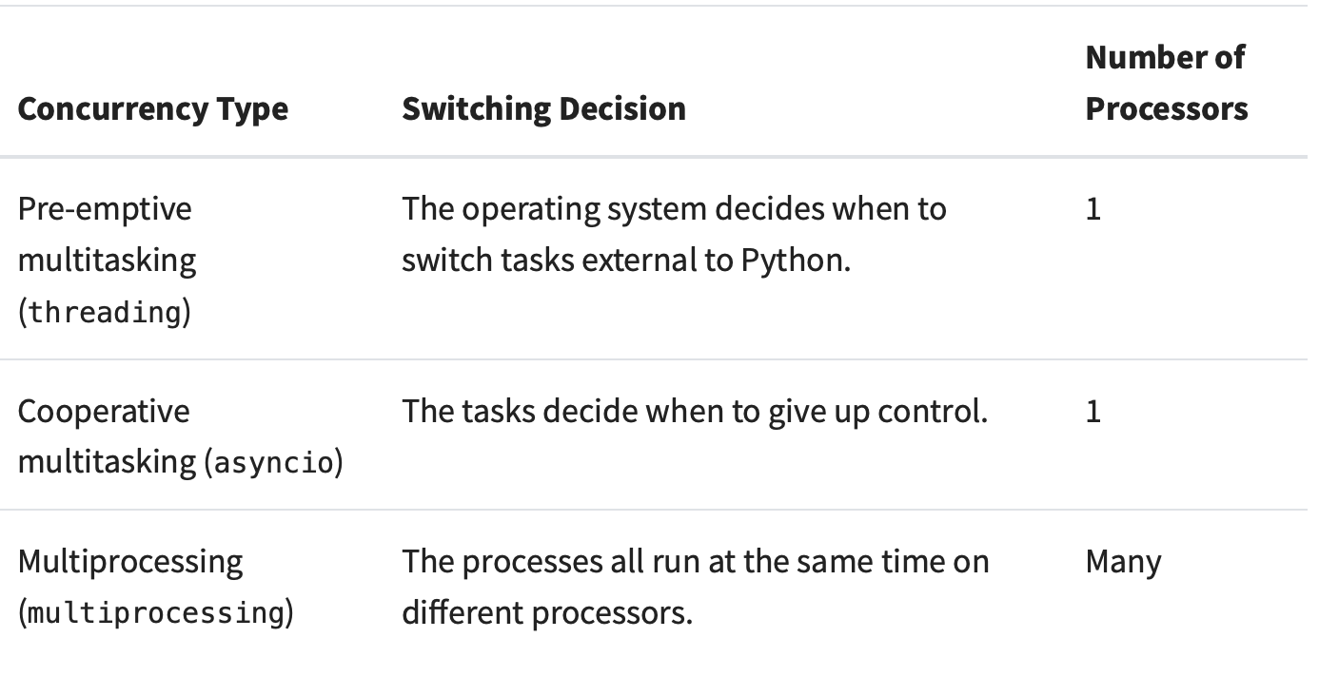
Summary of Different Concurrency Types in Python

Slide 30
CPU-Bound and I/O-Bound Programs in in Python
I/O-bound problems cause your program to slow down because it frequently must wait for input/output (I/O) from some external resource. For example, scraping data from many websites is an I/O bound problem. What limits the program from running faster is time spent interacting with the file system and network.
CPU-bound problems: classes of programs that do significant computation without talking to the network or accessing a file. These are the CPU-bound programs, because the resource limiting the speed of your program is the CPU, not the network or the file system.

Slide 31
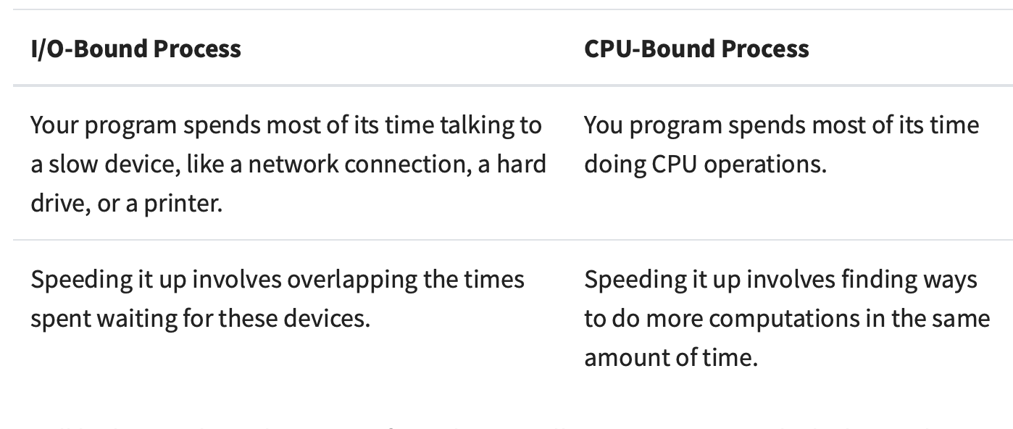
I/O Bound Vs. CPU Bound Processes

Slide 32
How to Achieve Concurrency in Python
There are several libraries which tackle this problem in Python depending on whether the problem is IO or CPU bound and also expressiveness of the library
asyncio-For IO bound programs such as downloading data from the web, this package is useful to run concurrent tasks
Multiprocessing: This is a builtin Python library for speeding up CPU bound programs by creating many processes to take advantage of multiple cores on your computer
Other libraries: Joblib, concurrent.futures which provide similar functionality but at a higher level

Slide 33
How to Solve Big Data Problems in Python

Slide 34
Working with data in a distributed fashion is inherently difficult, therefore make sure that you exhaust all options before jumping into using Spark, Hadoop or other Big Data frameworks

Slide 35
Advice on Tackling a Big Data Problem
Some questions to ask yourself before you jump to the big guns
Can I optimize pandas to solve the problem?: If you are using Pandas for data munging, you can optimize pandas to load large datasets depending on the nature of your problem
How about drawing a sample from the large dataset? Depending on your use case, drawing a sample out of a large dataset may or may not work. Just be careful that you sample correctly.
Can I use simple Python parallelism to solve the problem on my laptop? Sometimes the data isn't that big but you just need to run more intense computations on the smaller data, multiprocessing can help.
Can I use a big data framework on my laptop? For some tasks, even with a 25GB dataset, frameworks like Spark and Dask can work on a single laptop.
Need to build a cluster: Take time to think about which distribution of Hadoop to use, which vendors to use, whether you will put the cluster on the cloud or on-premise. You will need input of IT people for this one.

Slide 36
Further Reading on Parallelism
Python multiprocessing library
This is an excellent book-High Performance Python, I have the hard copy.
This site has good summary on parallelism in Python

